Slide 1
DIGESTIVE SYSTEM LOWER PART
BY
Assistant Proof Methaq A.Abdalsammad

Slide 2
Disorders of Rumen
1)Rumenitis due to lactic acidosis
Ingestion of diets high in grain (carbohydrates) can result in a life-threatening condition called lactic acidosis. Increased fermentation of carbohydrates causes a shift in the rumen microflora to favor Streptococcus bovis that tolerates the lower pH (<5) created by the accumulation of volatile fatty acids. As the pH lowers, lactobacilli begin to predominate and large amounts of lactate accumulate in the rumen. Some lactate diffuses into the blood stream creating systemic acidosis. At the same time the osmotic pressure of the lactate in the rumen draws body fluids into the rumen resulting in hemoconcentration and dehydration. Diarrhea often develops and the animal dies from hypovolemic shock.

Slide 4
If the animal survives the acute episode, the rumen mucosa may be damaged resulting in ulcers and erosions. These erosions and ulcers may be secondarily infected with fungi resulting in mycotic rumenitis. Ulcers often provide a breach for Fusobacterium necrophorum or Corynebacterium spp. to gain entry to the blood supply and cause hepatic abscesses and hepatic necrosis. These hepatic lesions are common in feedlot cattle fed high concentrate diets.

Slide 5
Rumen tympany
Rumen tympany or bloat is defined as filling the rumen with gases either free gases or mixture with food .It is common in cattle and represents a life threatening emergency.
Primary bloat is also called frothy bloat. Plant materials high in soluble proteins such as legumes, especially alfalfa, are often the offending substances. The proteins are partially degraded by microbes and become denatured so that they stabilize the foam. These small gas bubbles do not coalesce into larger bubbles so that the accumulated gas cannot be eructated. In order for an animal to eructate, the receptors near the esophagus need to be exposed to air – a lot of small stable bubbles don’t qualify as air.Consumption of feed material that is high in legumes (like alfalfa) will cause froth to form in the rumen and all those little bubbles can’t be eructated.

Slide 6
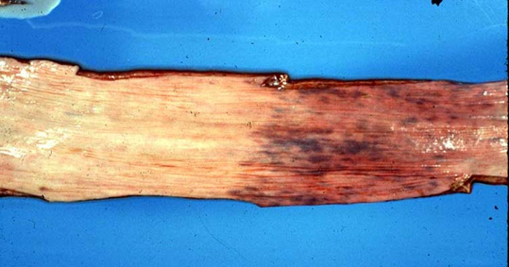
Secondary bloat results in accumulation of gas due to an inability to eructate the normal gas from the rumen. Causes include obstruction of the esophagus, vagal nerve paralysis, and adhesions.
This appearance of the esophageal mucosa is diagnostic for bloat. The thoracic part of the esophagus is on the left, where structures have all been compressed because of the pressure and blood is not present in the capillaries due to all this pressure. On the right is the cervical part (more anterior) of the esophagus, where everything is congested because blood can’t flow back into the thorax due to the high pressure.

Slide 7
Disorder of Stomach
Gastric Ulceration ( glandular stomach):
Any acute disruption in the stomach can cause acid to enter the mucosa and eat through, causing ulcers.
For ulceration to occur, there has to be an imbalance between the necrotizing effects of gastric acid and pepsin on one hand, and the ability of the mucosa to maintain its integrity on the other.
Hypersecretion of hydrochloric acid may be due to increased parietal cell mass or increased release of HCl from parietal cells as a result of increased histamine levels. Increased histamine levels are seen in dogs with mast cell tumors – the neoplastic mast cells release histamine which then stimulates the parietal cells to secrete HCl.

Slide 8
Ulcer progression
Once the superficial portion of the mucosa is destroyed, natural local buffering by surface cells is lost ,and the proliferative compartment of the gland, which is near the surface, is obliterated, preventing a local epithelial reparative process. Necrosis then extends rapidly to the muscularis mucosae causing necrosis.If the necrosis continues, the ulcer may extend through the muscularis and serosa and results in perforation of the gastric wall.
Any chronic inflammation in the stomach will lead to atrophy. With atrophy there is a decrease in the parietal cell mass which means less HCl and therefore no protein digestion. Because protein can’t be broken down once past the stomach, those big osmotic molecules just move right on through the tract, taking lots of water with them and being completely unavailable for absorption. Therefore diarrhea. Ostertagiasis in the abomasum of cattle is an example of a disease that causes gastric atrophy

Slide 9
Disorder of the Intestines :
Diarrhea: It means increase in abnormal fluid with increase frequency of defecation.
Mechanisms of diarrhea
Most diarrheas are due to one or a combination of three basic pathogenic mechanisms:
-malabsorption
-secretion
-effusion

Slide 10
Malabsorptive diarrhea
Decreased absorption of solutes from the lumen occurs in villus atrophy, just because there is not enough surface area to do the required work. The solutes and electrolytes that are not absorbed because water to be osmotically attracted into the lumen from the mucosa, with the result that the contents in the lumen are mostly fluid and exceed the absorptive capacity of the colon. Also, with those diseases where there is decreased protein breakdown (pancreatic insufficiency, Ostertagia in (cattle), the big old osmotic proteins just stay in the lumen all the way through, and drag water with them.

Slide 11
Some agents specifically attack the villus tips, or absorptive areas. When the surface epithelial cells are lost, the villi will contract due to loss, causing the villi to become shorter, therefore villus atrophy.To distinguish this type of villus atrophy from the previous type, it would be necessary to examine the crypts carefully for signs of damage.
Coronaviruses and rotaviruses both have a predilection for the more mature cells at the villus tip.
Infection with coccidia also tends to cause this type of surface necrosis.

Slide 12
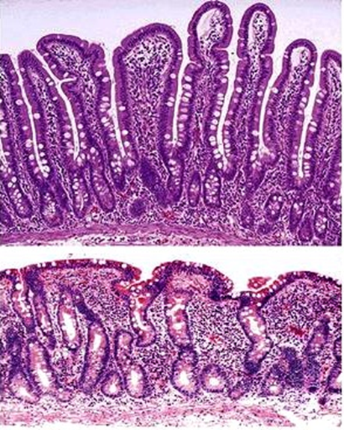
Photo on the right here → → → → →→ →→→
is a normal small intestine, long finger-like villi,
lots of cells lining to allow for maximum
absorption.
Photo on the right here → → → → → → → →
is villous atrophy, the villi are gone, and so
the surface area for absorption is drastically
decreased. this would result in a malabsorptive diarrhea.

Slide 13
Thank you for listening

